Slide 1

OPENING DAY
President’s Welcome
August 13, 2019
Notes:
Welcome everyone
Invite Academic and Classified Senate Presidents to join you in welcoming everyone back

Slide 2
Diana Tedone-Goldstone
Academic Senate President
Notes:
Introduce Diana Tedone-Goldstone (give her 1-3 minutes)

Slide 3
Academic Senate Recognitions
KIRAN MALAVEDE, English faculty
  Received Cañada Academic Senate 2018-19 award for Outstanding Part-Time Faculty.
DAVID ECK, Philosophy faculty
  Received Cañada Academic Senate 2018-19 award for Outstanding Full-time Faculty.
LORETTA DAVIS RASCON, Counseling Office Assistant
  Received Cañada Academic Senate 2018-19 award for Outstanding Classified Staff.

Slide 4
Jeanne Stalker
Classified Senate President
Notes:
Introduce Jeanne Stalker (give her 1-3 minutes)

Slide 5
New to the team…
Erika Bojnowski, Instructional Aide, ASLT Division
Alex Claxton, PRIE Analyst
Manasi Devdhar-Mane, PSC, International Student Center
Jillian Gomez, Retention Specialist, Counseling
Lezlee Inman, Rad Tech Instruction & Clinical Coordinator
Althea Kippes, Business Instructor
Graciano Mendoza, Vice President of Administrative Services
Klaressa Ortiz, Sparkpoint Coordinator
Manuel Alejandro Pérez, Vice President of Student Services
Ganapathy Shankar, Business Instructor
Alessandra Zanassi, Executive Assistant, Office of Instruction
Notes:
Also discuss Adam Windham’s departure and process for identifying a new Dean

Slide 6
President’s Recognitions
ESL DEPARTMENT – Received Redwood City Together’s Welcoming Stars Award
ADOLFO LEIVA, SparkPoint - Recognized with the 2019 McCown-Takalo Hunger Hero Award at the Second Harvest Food Bank of Santa Clara and San Mateo Counties
RAY LAPUZ, SUMATHI SHANKAR, DAVID MONARRES, and MICHAEL HOFFMAN, Math faculty, along with DOUG HIRZEL, DANI BEHONICK, Biology, led the 2018-19 Faculty Learning Program – led 12 of their STEM and non-STEM colleagues to complete the program.
NICK DEMELLO, Chemistry faculty -Recognized by the State Chancellor’s Office for his work submitted to reimagine online learning toward an all-online community college. Out of 180 proposals submitted, his was selected as one of three “Top Ideas!”
Everyone! – The College Patience Award
Notes:
ESL DEPT AWARD:
Received Redwood City Together’s Welcoming Stars Award. The award is designated to those who lift up programs in Redwood City and North Fair Oaks and are committed to and excelling at creating a welcoming environment for all in our community, especially immigrants. By providing ESL learning on campus and at various school sites in Redwood City and North Fair Oaks, the ESL Department prepares immigrants in the community to achieve their academic, vocational, and personal goals.
ADOLFO LEIVA, SparkPoint,
Recognized with the 2019 McCown-Takalo Hunger Hero Award at the Second Harvest Food Bank of Santa Clara and San Mateo Counties Harvest of Knowledge Conference. This award recognizes leaders who possess honesty, compassion and integrity. It also celebrates a community champion who serves as a spokesperson for the underserved, creative problem solver and always puts the needs of the clients first. Adolfo is the driving force behind the launch of Cañada’s new Community Market.
FACULTY LEARNING PROGRAM:
RAY LAPUZ, SUMATHI SHANKAR, DAVID MONARRES, and MICHAEL HOFFMAN, Math along with DOUG HIRZEL, DANI BEHONICK, Biology led the 2018-19 Faculty Learning Program – allowing 12 of their STEM and non-STEM colleages to complete the program.
Those who completed:
Science & Technology Faculty:
NICK DEMELLO and GUIBO ZHU, Chemistry
VERA KLIMKOVSKY and HONGYAN MENG, Math
JAMES HOFFMAN, Computer Science
CHERYL CATHEY, Engineering
SUSAN WHITE, Biology
JEANNE DIGEL, Astronomy
MICHELLE BEATTY, Math, now at CSM
Humanities & Social Sciences faculty:
DAVID ECK, Philosophy and LEZLEE WARE, Political Science:
Business, Design, and Workforce Development faculty:
CANDICE NANCE, Business
Completed the first college-wide Faculty Learning Program (FLP) comprised of training on learning theory and research-based effective practices for STEM classes. This was followed in training in a classroom observation protocol and three peer-led observations and reflections.
This intensive program encouraged these professors to deepen their knowledge of how people learn, reflect on their own teaching practices, provide thoughtful feedback to their peers, and strategically change how they teach. Completing the Faculty Learning Program confirms dedication to advancing the way faculty engage students in STEM courses in order to promote student learning and success.
These professors are now considered Faculty Fellows for the program and they are qualified to facilitate the program for other faculty.
HYLA LACEFIELD, Digital Arts & Animation faculty, Business, Design, and Workforce Development
Named among the District honorees in recognition of Women’s History Month. The Board of Trustees honored individuals for their commitment to students and were celebrated for their many personal and professional achievements and contributions:
NICK DEMELLO, Chemistry faculty, Science & Technology Division
Recognized by the State Chancellor’s Office for his work submitted to reimagine online learning toward an all-online community college. Out of 180 proposals submitted, his was selected as one of three “Top Ideas!” His proposal explored use of teaching teams. Large, online classes would be owned by teams of three instructors. Each instructor would rotate through the roles of designer, instructor, and assessor. By rotating roles each semester, teaching would remain fresh, allow faculty to explore greater variety of classes and provide integrated support for the more challenging ones.
PATIENCE AWARD: Thank the campus community for their patience and flexibility during the capital improvements/renovations.

Slide 7
College-wide Achievements 2018-19
  Accreditation Report (ISER)
  Shuttle
  2nd year of Promise
  First President’s luncheon: $65K raised
  2nd annual Awareness Summit
  Implementation of AB 705 (the new Writing Center)
Notes:
Accreditation Report (ISER) – ask the Standard Tri-Chairs and Steering Committee members to stand and be acknowledged. Report was approved by the Board of Trustees on July 25 and is now in the hands of the ACCJC and the Visiting Team in preparation for their visit on September 30 – October 3
Shuttle
2nd year of Promise: 327 last year – 500 this coming year!
President’s luncheon raised $60K for student scholarships – we hope to raise even more this year on October 22nd
2nd annual Awareness Summit – on-going work with our community partners to ensure our students’ basic needs are met
AB 705 – acknowledge all the great work done by English and math faculty – and counselors and assessment staff – to get ready for the successful implementation of AB 705 (see data slides on this below)

Slide 8
Athletic Achievements
  Women’s Soccer Team Undefeated in conference play
  Named 2018 Coast Conference Champions for the first time since 2003.
  Men’s Basketball Team Ranked in State Top 10
  The Colts ended the season ranked 9th in California with 22 wins and 8 losses.
  Men’s Soccer finished season with an 11-4-4 overall record
  Finished 7th in Northern California
  Finished 19th in the State
  Student Athletes Successfully Transfer to Universities
  In Spring 2019, more than 30 Cañada College student athletes successfully transferred to universities, many securing scholarships to continue as student athletes.

Slide 9
What is our “why”?
Organizations who are successful start with the “why” not the “what”
When your “why” aligns with your “what”, you have integrity
If it doesn’t, you have hypocrisy
Notes:
By reflecting on our “why” – our “what” and “how” can become clearer

Slide 10
Mission
Cañada College provides our community with a learning-centered environment, ensuring that all students have equitable opportunities to achieve their transfer, career education, and lifelong learning educational goals. The College cultivates in its students the ability to think critically and creatively, communicate effectively, reason quantitatively, and understand and appreciate different points of view within a diverse community.
Notes:
What brings YOU to work every morning?

Slide 11
College Metrics

Slide 12
College Metrics:
Transfer-level Placement of First-time Students
Notes:
Discuss the implementation of Multiple Measures placement over the past few years – the work of the Assessment Office in scaling the use of high school transcripts to more accurately place students. The work of the math and English departments on preparing for the implementation of AB 705. The work of counselors in helping students understand their choices and navigate these changes.

Slide 13
College Metrics:
Transfer-level course success rates

Slide 14
College Metrics:
Overall Student Course Success Rates

Slide 15
College Metrics:
Degrees & Certificates Awarded

Slide 16
College metrics:
Transfers
Notes:
TOTAL transfers: UC, CSU and private

Slide 17
College Metrics:
Fall to Spring Persistence

Slide 18
Student Cohort Fall to Spring Persistence Rates, 2018-19
Student Sub-Population | Persistence Rate
College for Working Adults | 91%
STEM Center | 89%
Promise Scholars | 88%
First-time full-time students | 83%
Cañada "home" campus students | 63%
All students enrolled at Cañada | 57%
Notes:
There is a strong correlation between the number of units students take and how connected and supported they feel and whether or not they persist.
Our Guided Pathways efforts (which we will hear more about shortly) are meant to help us scale promising practices and programs so that more of our students feel connected and supported to campus.

Slide 19
College Metrics:
Enrollment
Notes:
Over the last 5 years, our Headcount is down about 5%, but our FTES is down 16%

Slide 20
We are disproportionately losing students who take more units (over the last 5 years)
Students taking at least 24 units/year
-3%
Notes:
Over the last five years, the number of students taking at least 24 units per academic year has declined, while those taking less than 12 units per year has increased. This has a big impact on our FTES.
The Strategic Enrollment Management Committee will continue to explore these enrollment dynamics and develop a new plan for addressing them.
KEEP IN MIND: Nearly one out of every two Cañada students is working more than 20 hours/week.

Slide 21
Priorities
Understand and address the reasons for our decline in FTES
Dramatically increase our persistence rates
Notes:
Given the trends identified in our benchmark data, it is clear we need to turn our attention to managing our enrollment more strategically and scaling the practices and programs that improve student persistence and, thereby, success.

Slide 22
Leadership Retreat 2019
Theme of Retreat: Work Smarter Not Harder
Management Training: College Fundamentals of Planning & Budgeting
Reviewing Strategic Priorities developed 2018-19
Discussing the results of the Campus Climate Survey

Slide 23
Leadership Retreat Participants: 31
Adolfo Leiva
Alicia Aguirre
Allison Hughes
Brian Tupper
Candice Nance
David Eck
David Reed
Diana Tedone-Goldstone
Diva Ward
Georganne Morin
Graciano Mendoza
Hyla Lacefield
James Carranza
Jamillah Moore
Jeanne Stalker
Julian Branch
Karen Engel
Leonor Cabrera
Manuel Alejandro Pérez
Margie Carrington
Maria Huning
Maria Lara
Marisol Quevedo
Mary Chries Concha Thia
Mary Ho
Max Hartman
Mayra Arellano
Megan Rodriguez-Antone
Michiko Kealoha
Ruth Miller
Tammy Robinson

Slide 24
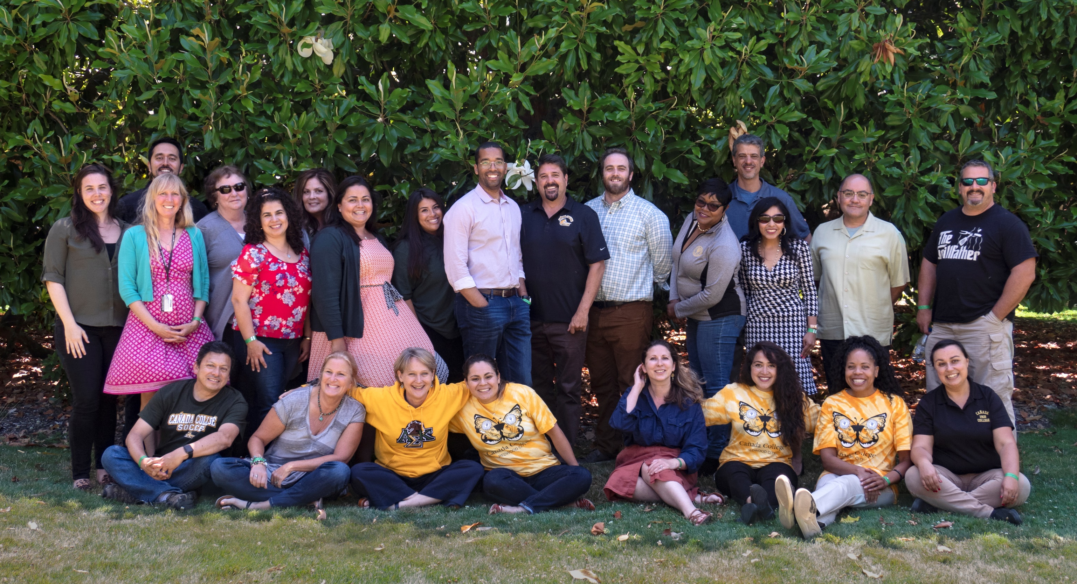
Notes:
Photo taken at the Retreat side – Filoli.

Slide 25
Strategic Priority Projects for 2019-20
CRM
Interest Areas & Program Maps
Early College
Online Instruction
Academic Support
First Year Experience
Career Exploration
Job Placement
Notes:
These priorities were synthesized from the College EMP, Guided Pathways Steering Committee, Strategic Enrollment Management Committee, Student Equity & Achievement Plan, Strong Workforce goals, Chancellor’s Vision for Success, and the SMCCCD Board of Trustees (re Job Placement).
Many of these are multi-year efforts/goals.
Today’s Poster Session will provide an opportunity for everyone to develop a shared understanding of that these projects are and how they help us reach our WHY.
Re-Design College Processes: CRM
Streamline the matriculation process
Organize student “Success Teams” aligned with Interest Areas
Build data dashboards and train data coaches to support these efforts
Scale the number of Peer Mentors aligned with Interest Areas and programs
Establish Interest Areas and Program Maps (implement Program Mapper)
Use the program mapping exercise to optimize the course schedule for student completion
Develop Career Exploration opportunities for students that are aligned and integrated with Interest Areas
Re-design Academic Support (launch Writing Center, scale peer mentoring and EPIC supplemental instruction programs and integrate retention programs into larger academic support structure)
Build First Year Experience (FYE) programs (start at October Flex) aligned with Interest Areas
Expand opportunities for Early College experiences (dual enrollment; Middle College)
Expand College capacity to assist students with Job Placement
Create an equitable experience for Online Students to support student success

Slide 26

Notes:
The Leadership Team spent some time – as have other groups during the course of the year – brainstorming a “name” for our efforts. A short-hand for the college innovation and systems building work we will do this year and next.
The result: “Colt-ivate”!

Slide 27
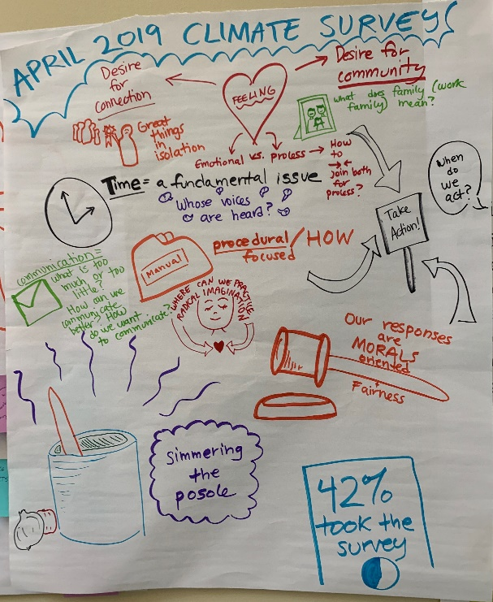
Climate Survey results and next steps
Leadership carefully reviewed the results of the survey
Immediate next steps:
  Organize a community-building event this Fall – Classified Senate to take the lead!
  Create a more structured on-boarding process for new employees
  Be more intentional about using Fridays as time for campus collaboration
Notes:
Leadership carefully reviewed the results of the survey – process facilitated by our new VPSS, Manuel Perez
Immediate next steps:
Organize a community-building event this Fall – Jeanne Stalker and the Classified Senate have offered to take the lead on this
Create a more structured on-boarding process for new employees - College Council will take the lead on developing this. Input from everyone is welcome.
Be more intentional about using Fridays as time for campus collaboration

Slide 28
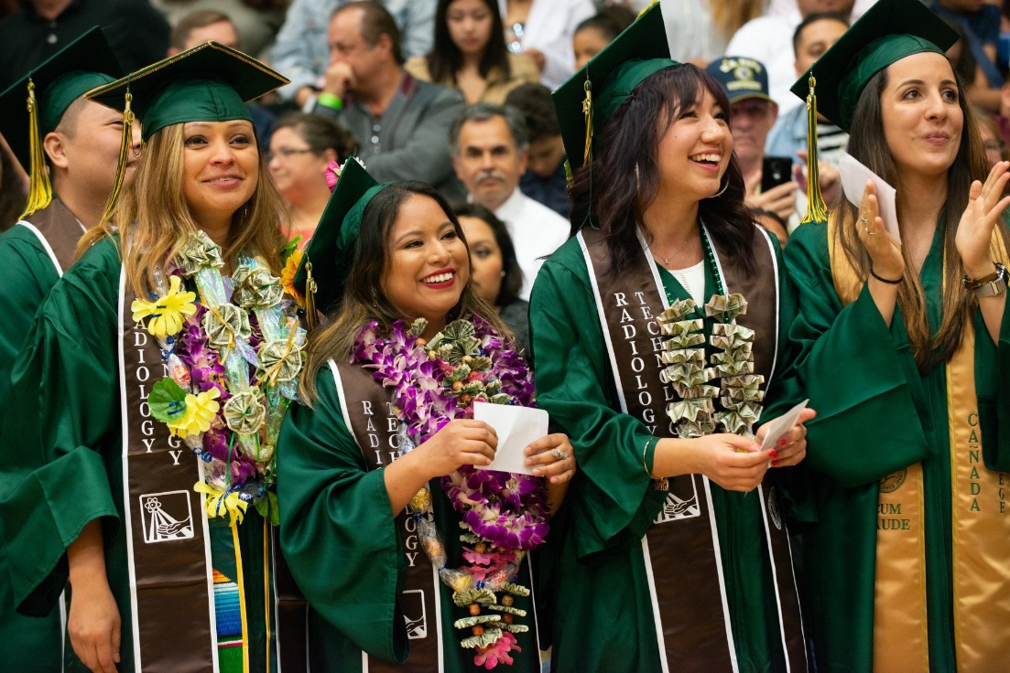
Student Success

Slide 29
Announcements
Save the Date: October 22nd for our Second Annual President’s Luncheon
Free direct shuttle service from campus to/from East Palo Palo will continue. The schedule can be viewed at www.canadacollege.edu/shuttle.
Free SamTrans rides for Cañada students August 14-31. Passes will be available
  August 14 from 9 a.m. – 1 p.m.
  August 15 from 6 p.m. – 8 p.m.
  August 19 from 9 a.m. – 1 p.m.
Other announcements?
Notes:
Read bullets and then let people pop up and make any announcements
Include:
Denise Erickson - GE Pathways Events
Jessica Marhsall

Slide 30
Preparing for the Accreditation Peer Review Team Visit
Flex Day
August 13, 2019

Slide 31
Agenda
  Where are we in the process?
  Acknowledgements
  Who’s on the Visiting Team?
  Accreditation Standards
  Compendium of Committees
  What to expect from the Visit
  “Schoolhouse Rock” presentation

Slide 32
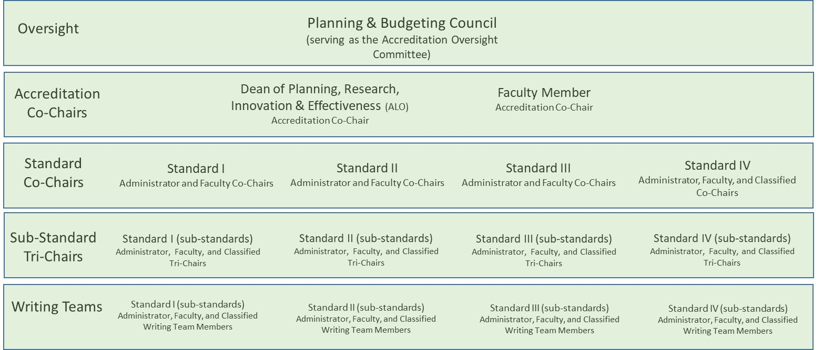
Acknowledgements

Slide 33
Where are we in the process?
The review process includes four steps:
An internal self-evaluation – DONE!
An external evaluation by a team of peer reviewers (scheduled for September 30 - October 3, 2019)
Commission review and accreditation action (January, 2020)
An institutional response to recommendations for improvement (2020)

Slide 34
Dr. Keith Flamer (Chair) President/Superintendent College of the Redwoods | Ms. Johanna Helzer (Assistant) Administrative Office Coordinator College of the Redwoods
ACADEMIC REPRESENTATIVES
Ms. Kristina Allende Professor of English Mt. San Antonio College | Ms. Cheryl Bailey Instruction Librarian; SLO Coordinator Irvine Valley College
Mr. Caleb Fowler Assistant Professor Computer Info. Science; Business Folsom Lake College | Ms. Georgie Monahan Faculty, Communication Studies & Program Review Coordinator Orange Coast College
Dr. Tish Young Senior Dean of Instruction Contra Costa College
ADMINISTRATIVE REPRESENTATIVES
Dr. Valerie Barko Director of Institutional Effectiveness and University Center/ALO Kauai Community College | Mr. Robert Suppelsa Vice President Administrative Services Los Angeles Harbor College
Dr. Ryan Theule Vice President, Canyon Country Campus & Grants Development College of the Canyons | ACCJC STAFF LIAISON Dr. Richard Winn President ACCJC

Slide 35
Accreditation Standards
Standard I: Mission, Academic Quality and Institutional Effectiveness and Integrity
Standard II: Student Learning Programs and Support Services
Standard III: Resources
Standard IV: Leadership and Governance

Slide 36

Accreditation Standards and the College’s Participatory Governance Structure
President
PBC
Staff
Faclty
Students
Admin
Accreditation Oversight Committee (all standards)
ASCC
(students)
Academic Senate (faculty)
ClassifiedSenate (staff)
Standards I.C, IV.A
Standards I.C, II.A, II.B, III.A, IV.A
Standards I.C, IV.A
Staff
Faculty
Students
Administrators
Staff
Faculty
Students
Administrators
Staff
Faculty
Students
Administrators
APC
IPC
SSPC
Standards III.A and III.D
Standards II and I.C
Standards II.B and II.C

Slide 37
Accreditation Standards and the College’s Participatory Governance Structure
President
PBC
Staff
Faclty
Students
Admin
Accreditation Oversight Committee (all standards)
ASCC
(students)
Academic Senate (faculty)
ClassifiedSenate (staff)
Standards I.C, IV.A
Standards I.C, II.A, II.B, III.A, IV.A
Standards I.C, IV.A
Staff
Faculty
Students
Administrators
Staff
Faculty
Students
Administrators
Staff
Faculty
Students
Administrators
APC
IPC
SSPC
Standards III and IV: Supported by District Functions: Human Resources, Finance, ITS, Facilities, Chancellor, Board of Trustees
Standards III.A and III.D
Standards II and I.C
Standards II.B and II.C

Slide 38
Compendium of Committees
Engaging faculty and staff for 2019-20

Slide 39
College Committee Reporting Structure
President
Academic Committee for Equity and Success (ACES)
Strategic Enrollment Management Committee
Report to the Planning & Budgeting Council (PBC)
PBC
Staff
Faclty
Students
Admin
ASCC
(students)
Academic Senate (faculty)
ClassifiedSenate (staff)
Curriculum Committee
Distance Education Advisory Committee
Subcommittees of the Academic Senate
Staff
Faculty
Students
Administrators
Staff
Faculty
Students
Administrators
Staff
Faculty
Students
Administrators
APC
IPC
SSPC
Environmental Sustainability Committee
Professional Learning Committee
Safety Committee
Report to the Administrative Planning Council (APC)
Honors Transfer Program Committee
Technology Committee
Report to the Instructional Planning Council (IPC)

Slide 40
What to expect when the ACCJC visit team comes
Team Welcome event on Monday, Sept, 30 – faculty, administrators, classified staff, students, and board members (especially the college leaders and those closely involved with the ISER)
Team will use 6-111 as their office/home base during the visit (private)
The team will ask questions and will want to talk with various college constituents.
  Visits with college committee/council meetings, classrooms (on campus and online), and facilities.
  Meetings will be requested ahead of time and throughout the process.
  Requests for additional information will be made before, during, and after the visit.
If there are any concerns during the visit, the team will discuss them during the exit interview/meeting on Thursday, October 3. Everyone is encouraged to attend.

Slide 41
The ‘New’ ACCJC
Visit from Stephanie Droker, Senior Vice President of ACCJC, on September 11th at noon to engage with all of us and help us prepare for the visit.
Focus is on our self-evaluation/reflection:
  what we are doing well
  what we need to improve, and
  what we are in the process of improving.

Slide 42

Coming to Division and Senate meetings in September…

